Slide 1
ST-LADDERNET: SPATIAL-TEMPORAL CORRELATION STEPPLY ENHANCED DEEP LEARNING MODEL
FOR URBAN TRAFFIC PREDICTING
Branch & Section: CSD-A
Department:
Computer Science & Engineering(Data Science)
College:
Lords Institute of Engineering & Technology
Academic Year: 2026-2027
Company: MANAC infotech
Student names & Roll Numbers:
Mohammed Yaser(160923750012)
Mohammed Idrees(160923750043)
Abdullah (160923750059)
Supervisor: Mr. Aqeel Haider Shams

Slide 2
Introduction
Urban traffic prediction is important for efficient transportation, urban planning, and reducing traffic-related environmental impact.
Traffic conditions are influenced by both location-based patterns and changes over time.
Traditional CNN, LSTM, and similar models often process spatial and temporal information separately, limiting their ability to capture complex traffic patterns.
Traffic conditions can vary significantly across different urban regions and time
periods, especially during congestion and sudden changes.
Effective prediction requires learning multi-scale spatial relationships together with short-term and long-term temporal dependencies.
ST-LadderNet is proposed to improve spatial-temporal feature learning using a ladder CNN and GRU-based approach

Slide 3
Problem Statement
Urban traffic patterns are highly dynamic, making accurate prediction difficult.
Existing models often process spatial and temporal dependencies separately or
sequentially.
They do not effectively capture multi-scale relationships between different urban regions.
Spatial features are often extracted without fully considering the temporal information associated with neighbouring areas.
Short-term traffic fluctuations and long-term traffic dependencies are not adequately
handled together.
Traffic noise and sudden variations can reduce prediction reliability, particularly during congested conditions.
Therefore, there is a need for a model that can effectively combine spatial and temporal
correlations for more accurate urban traffic prediction

Slide 4
Objectives
To develop an effective deep learning model for urban traffic prediction.
To capture spatial correlations between different urban traffic regions.
To learn both short-term and long-term temporal dependencies in traffic patterns.
To integrate spatial and temporal features using Ladder CNN and GRU.
To reduce the impact of irrelevant spatial noise and traffic fluctuations.
To improve the accuracy and robustness of traffic prediction.
To support prediction under dynamic and changing urban traffic conditions

Slide 5
Methodology
Traffic Data Collection: NYC Taxi grid dataset for model training; Hyderabad road speeds collected every 30 minutes (TomTom Traffic API / built-in simulator).
Data Preprocessing: Map readings onto a city grid, normalise values, and build input windows of recent, daily and weekly history.
Spatial Feature Extraction: Ladder CNN with a widening neighbourhood (3×3 → 5×5 → 7×7 cells) for recent → older time steps.
Temporal Feature Learning: GRU module learns short-term and long-term patterns from the sequence of spatial features.
Spatial-Temporal Integration: Ladder CNN features and raw inputs are fused and passed to the GRU.
Traffic Prediction: Forecasts 15–60 min ahead (Hyderabad) and 30–120 min ahead (NYC).
Performance Evaluation: RMSE, MAE and MAPE, compared against Historical Average, Last Value and Linear Regression baselines.

Slide 6
Dataset & Preprocessing
Datasets Used
Preprocessing Steps
Map each road / region to a grid cell (Hyderabad: 16×16, ~2 km cells).
Scale values to 0–1 (speed ÷ free-flow speed, volume ÷ training maximum).
Inputs: last 4 hours + same time yesterday + same time last week.
Time-of-day and day-of-week features (sin / cos).
Chronological train / validation / test split (no future data leakage).
NYC Taxi (public benchmark): 10×20 city grid, 30-minute slots, 2 volume channels; 40 days training, 20 days testing.
Hyderabad corridors: 12 major roads (NH 65, Gachibowli, Tank Bund, LB Nagar…) with current and free-flow speed.
Live source: TomTom Traffic Flow API every 30 min; a built-in simulator is used until the API key is active.
▪
▪
▪
▪
▪
▪

Slide 7
Modules Implemented
# | Module | What it does | Status
1 | Data Collection | Fetches road speeds (TomTom / simulator) and weather on a schedule | Done
2 | Database | Stores roads, readings, forecasts and weather (SQLite / PostgreSQL) | Done
3 | Preprocessing | Grid mapping, normalisation, recent / daily / weekly input windows | Done
4 | ST-LadderNet Model | Ladder CNN + GRU implemented in PyTorch | Done
5 | Training & Evaluation | Trains on NYC Taxi data, compares with 3 baselines (RMSE, MAE, MAPE) | In progress
6 | Prediction Service | 15–60 min forecasts per road, congestion alerts, accuracy tracking | Done
7 | REST API | Flask endpoints serving live data, forecasts and history | Done
8 | Web Dashboard | Map, forecasts, alerts, analytics; deployed online | Done
9 | Live Hyderabad Data | Switch from simulator to TomTom real-time speeds | Pending API key

Slide 8
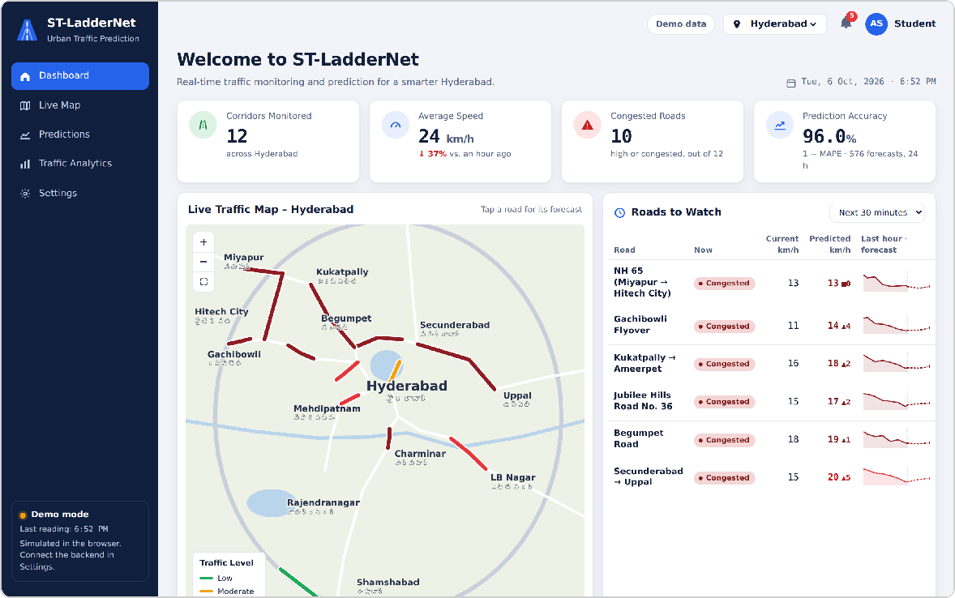
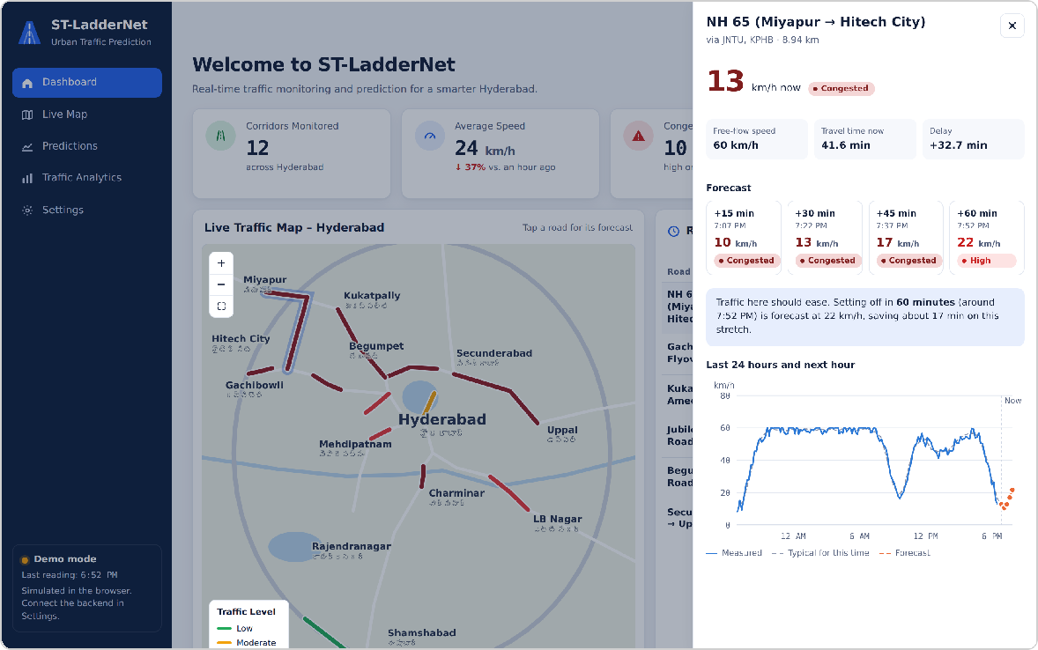
Implementation – Web Dashboard
Dashboard: live map, KPIs and roads to watch Road details: 15–60 min forecast and 24-hour trend
Live demo: https://st-laddernet.vercel.app (screenshots taken during evening peak, simulated data)

Slide 9
Results So Far
NYC Taxi test set (20 days), cells with more than 10 trips. Lower is better.
Model | 30 min ahead |  |  | 60 min | 90 min | 120 min
 | RMSE | MAE | MAPE | RMSE | RMSE | RMSE
Historical Average | 38.72 | 21.76 | 21.3% | 38.74 | 38.75 | 38.76
Last Value | 34.27 | 20.36 | 22.7% | 54.39 | 72.90 | 88.90
Linear Regression | 25.43 | 15.36 | 18.5% | 30.49 | 33.34 | 34.96
ST-LadderNet (initial run) | 46.36 | 25.02 | 26.4% | 48.46 | 52.54 | 58.13
ST-LadderNet (improved) | Training in progress – results to be updated
The initial model used only the last 4 hours, so it missed daily and weekly traffic patterns.
Improved version adds same-time-yesterday and last-week inputs, day-of-week features and a skip connection.
Target: beat the strongest baseline (Linear Regression, RMSE 25.43 at 30 min).

Slide 10
Tools & Technologies
Category | Technology
Programming Languages | Python 3.12, JavaScript
Deep Learning Framework | PyTorch
Spatial / Temporal Learning | Ladder CNN (Conv2D) / GRU (Gated Recurrent Unit)
Data Processing | NumPy
Backend / API | Flask (REST API)
Database | SQLite (development), PostgreSQL + TimescaleDB (production)
Frontend & Visualization | HTML, CSS, JavaScript, SVG charts, Leaflet + OpenStreetMap
External APIs | TomTom Traffic Flow API, OpenWeather API
Deployment & Tools | Vercel, Docker, VS Code, Git

Slide 11
Future Scope of Project
Real-Time Traffic Prediction: Integrate live traffic data from sensors, GPS, and traffic cameras.
Larger Geographic Coverage: Extend the model to more cities and a greater number of urban regions.
Improved Prediction Accuracy: Explore advanced deep learning techniques to further improve forecasting performance.
Weather Integration: Include rainfall, temperature, and other weather conditions that affect traffic flow.
Accident and Event Detection: Consider unexpected incidents and special events to improve traffic predictions.
Smart Traffic Management: Support intelligent traffic signals and route planning using predicted traffic conditions.
Deployment in Smart Cities: Integrate the model into smart city platforms for efficient transportation planning

Slide 12
Work Remaining
Complete training of the improved ST-LadderNet and update the results table.
Ablation study: effect of daily / weekly inputs and number of ladder rungs (1, 2, 3).
Connect real-time Hyderabad traffic data (TomTom / HERE Traffic API).
Host the backend and database online (e.g. Render + PostgreSQL).
Add planned features: user login, admin panel, route planner and PDF reports.
Final testing, project report and documentation.

